Slide 1

Phishing Awareness Training: Safeguarding Our Digital Footprint
In today's interconnected world, digital threats are more prevalent and sophisticated than ever before. Phishing attacks, in particular, have emerged as a significant cybercrime, using deceptive communication methods to trick individuals into revealing sensitive information or deploying malicious software. This module is designed to empower you with the knowledge and skills to effectively identify, avoid, and report phishing attempts, thereby safeguarding your personal and organisational digital footprint.
Understanding the nuances of these attacks is crucial, as they often exploit human psychology rather than just technical vulnerabilities. By the end of this training, you will be equipped to recognise the red flags, understand the tactics employed by attackers, and implement best practices to protect yourself and our collective digital assets.

Slide 2





The Phishing Landscape in India
India: A Prime Target
Financial Impact
According to Check Point Research's H1 2023 report, India consistently ranks among the top three countries globally targeted by phishing attacks. This makes awareness and robust defence mechanisms critically important for every individual and organisation operating within the region.
The average cost of a data breach in India has soared to an alarming ₹17.9 Crores, as reported by IBM in 2023. These costs include detection and escalation, notification, lost business, and post-breach response, highlighting the severe financial repercussions of successful phishing campaigns.
Surge in Cyber Incidents
Vast Internet User Base
CERT-In (Indian Computer Emergency Response Team) reported a staggering 1.39 Million cyber incidents in 2022. This upward trend underscores the relentless efforts of cybercriminals and the need for heightened vigilance across all sectors.
With 881 Million internet users as of January 2024 (Statista), India presents a vast attack surface for phishers. The sheer volume of online activity translates into more opportunities for attackers to deploy their deceptive tactics, making widespread awareness indispensable.

Slide 3
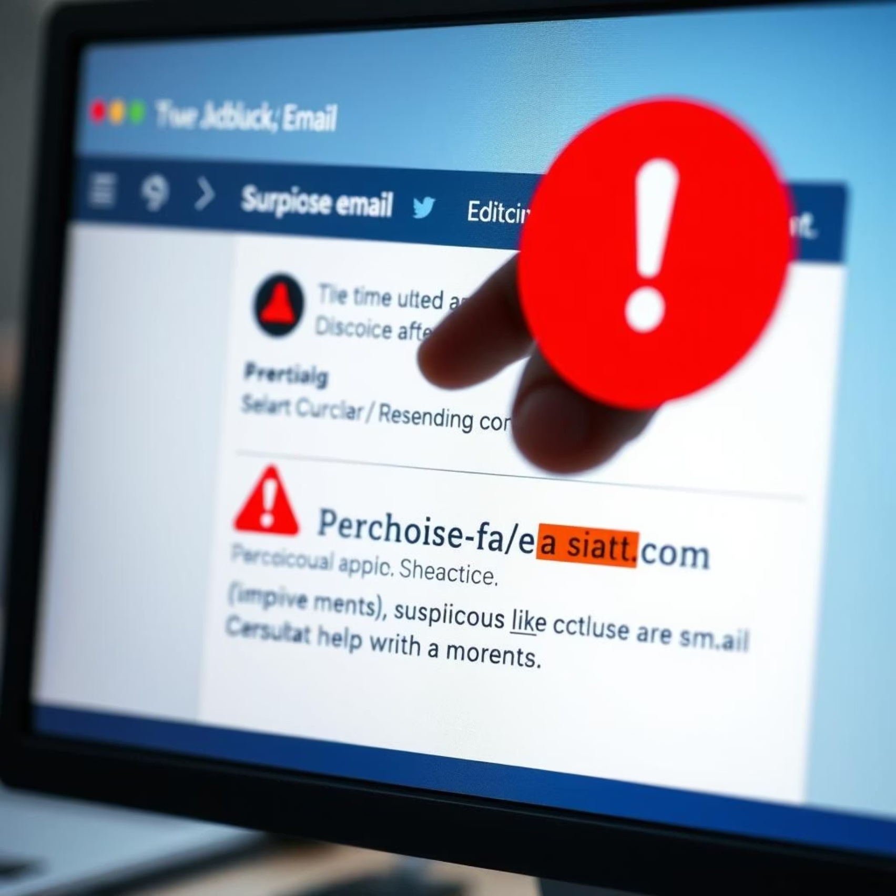
Anatomy of a Phishing Email
Phishing emails are crafted to appear legitimate, often mimicking trusted senders to trick recipients. Recognising the tell-tale signs is your first line of defence.
Suspicious Sender: Always scrutinise the sender's email address. Phishers often use generic domain names, misspellings of legitimate companies (e.g., amaz0n.in instead of amazon.in), or mismatched domains where the display name doesn't match the actual email address.
Urgent/Threatening Tone: Phishing emails frequently employ scare tactics or create a false sense of urgency to bypass rational thought. Phrases like "Account locked!", "Immediate action required!", or "Your service will be terminated!" are common ploys designed to make you act without thinking.
Grammar/Spelling Errors: Professional organisations maintain high standards for communication. The presence of numerous grammatical mistakes, misspellings, or awkward phrasing is a significant red flag that the email is not legitimate.
Suspicious Links/Attachments: Be extremely cautious of unexpected links or attachments. Malicious links might direct you to fake websites designed to steal credentials, while attachments can contain malware. Always hover over links (without clicking!) to see the actual URL, and never open unexpected files, especially if they are executable or compressed files.
By developing a keen eye for these elements, you can significantly reduce your risk of falling victim to phishing schemes.

Slide 4
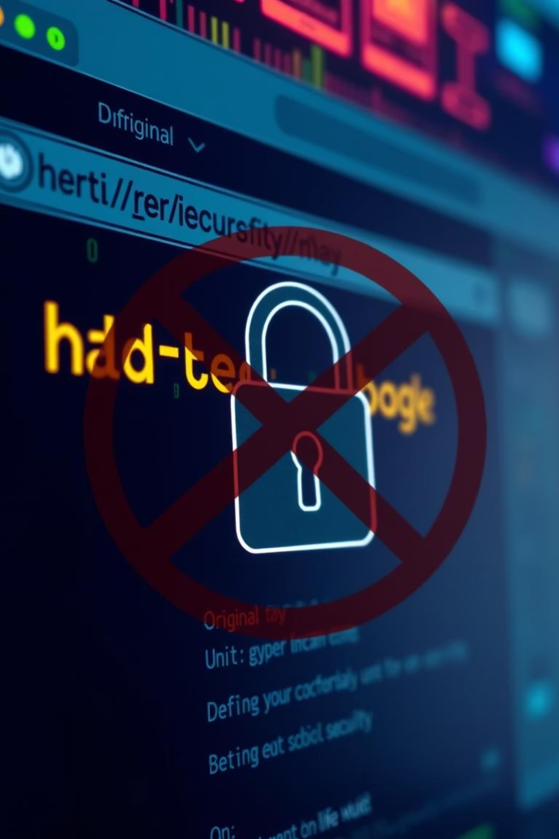
Spotting Fake Websites & Links
Beyond emails, attackers often create fake websites to harvest your credentials. These sites are meticulously designed to look authentic, making it challenging to differentiate them from genuine ones.
Incorrect URL (Uniform Resource Locator)
Always check the URL in your browser's address bar. Phishers use subtle tricks like typos (e.g., login.icicibnk.com instead of login.icicibank.com), extra words, or different top-level domains (.net, .org instead of .com or .in) to deceive you. Even a single character difference can indicate a fake site.
No HTTPS/Padlock Symbol
Legitimate websites, especially those requiring login credentials or personal information, use HTTPS (Hypertext Transfer Protocol Secure) to encrypt communication. Look for "https://" at the beginning of the URL and a padlock symbol in the address bar. If it's missing or shows "Not Secure," do not proceed.
Poor Design/Quality
While some fake websites are sophisticated, many exhibit signs of unprofessionalism. This can include low-resolution logos, inconsistent branding (e.g., different fonts, colour schemes), broken links, or generic images. These details can often reveal the site's inauthenticity.
Unusual Information Requests
Be wary if a website asks for information that seems excessive or unnecessary for the task at hand. Legitimate organisations rarely ask for sensitive details like your full credit card number, CVV, PIN, or multiple One-Time Passwords (OTPs) in a single transaction or for simple updates.

Slide 5








Understanding Social Engineering
Social engineering is a psychological manipulation technique employed by cybercriminals to trick individuals into divulging confidential information or performing actions that compromise their security. It's often the human element, rather than technical flaws, that provides the weakest link in the security chain.
What it is:
Urgency:
Social engineering leverages human psychology, trust, and natural curiosity to bypass security protocols. Attackers manipulate people into willingly providing access to systems or data that they shouldn't have.
A common tactic is to create a sense of urgency or panic. This forces the target to make quick decisions without proper deliberation, often leading to mistakes like clicking malicious links or sharing sensitive data.
Lure/Fear:
Authority:
Social engineering can also involve offering enticing incentives (like free goods or exclusive access) or threatening severe consequences (such as account suspension or legal action) to motivate the target to comply with their requests.
Attackers often impersonate trusted entities or individuals, such as bank officials, IT support, government agencies, or even your CEO. This plays on the natural human inclination to obey authority figures or trust established institutions.

Slide 6
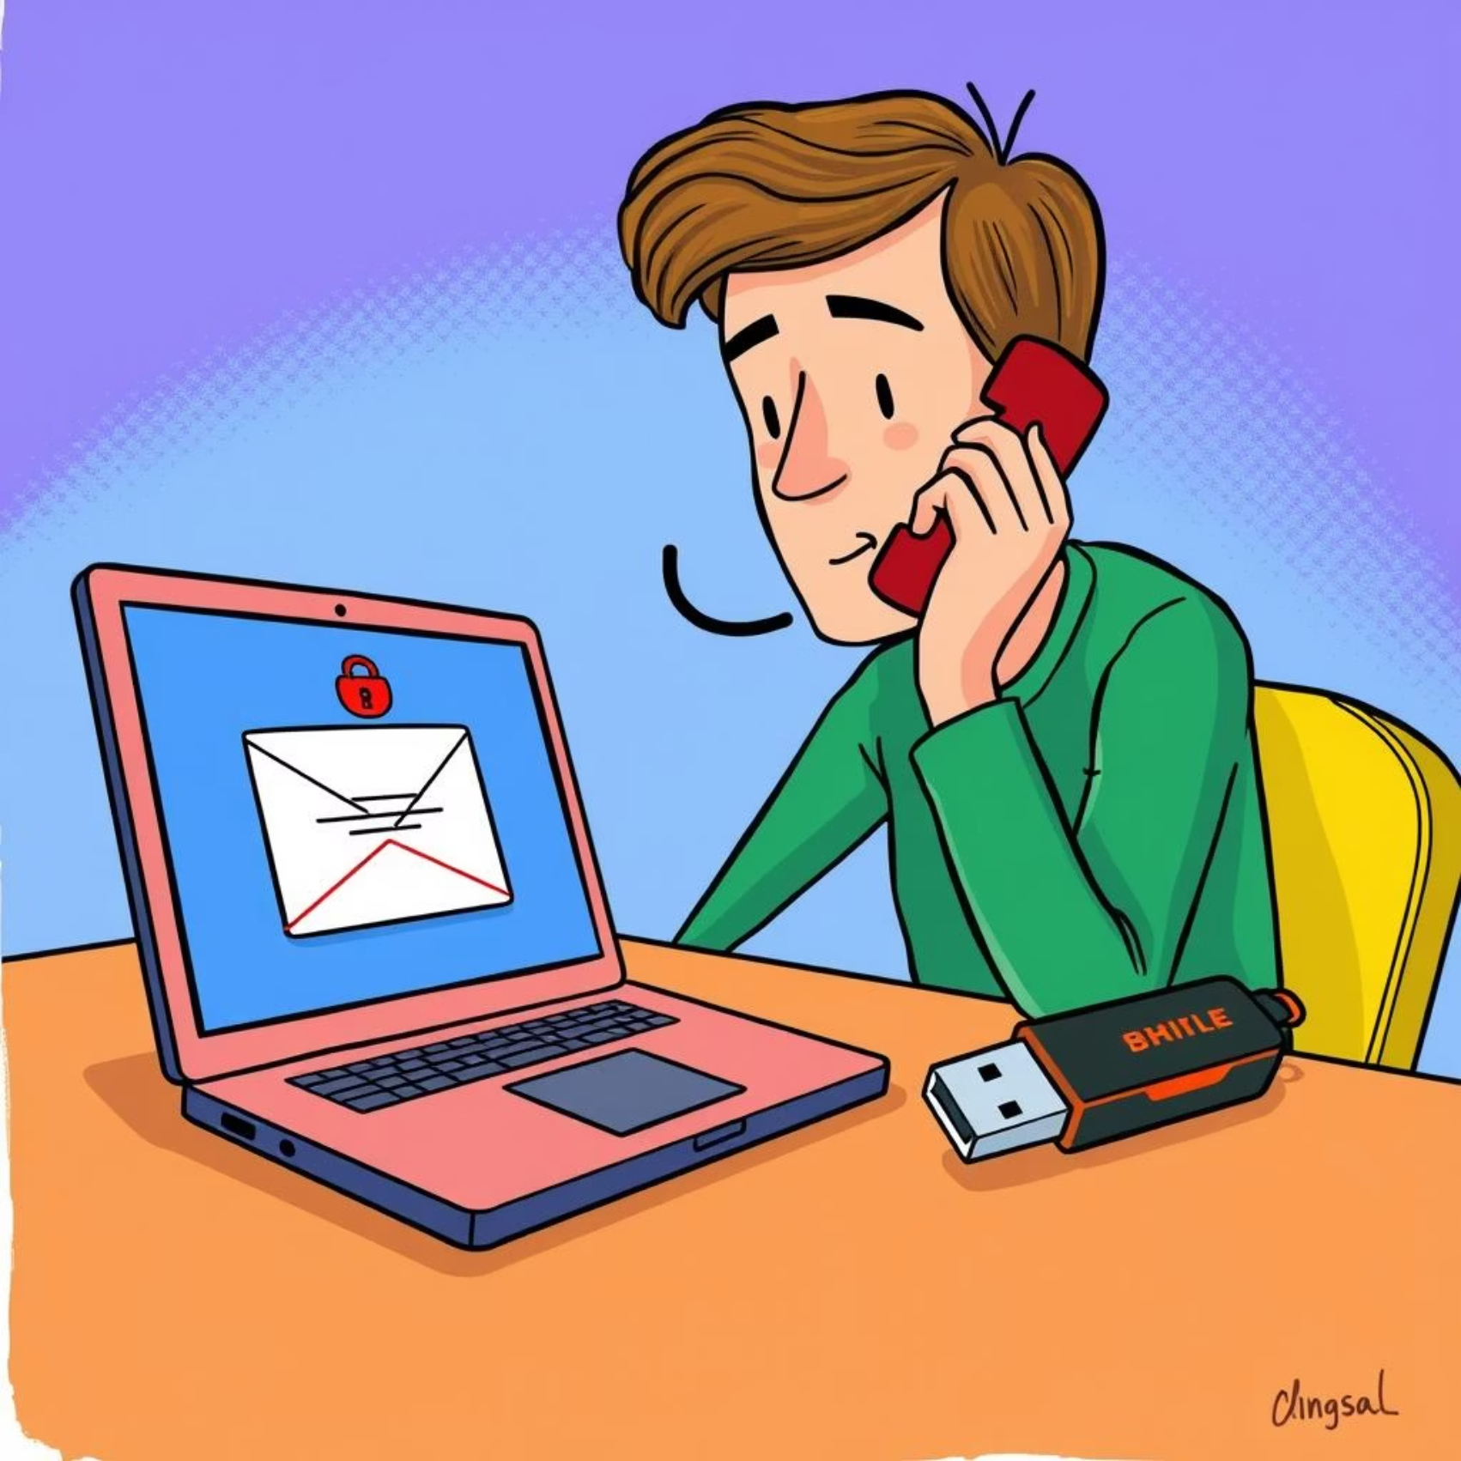
Common Social Engineering Tactics
Social engineers employ various sophisticated tactics, each designed to exploit different aspects of human behaviour. Understanding these methods is crucial for effective prevention.
Pretexting: This involves creating a fabricated scenario to engage the target and extract information. For instance, an attacker might call pretending to be from your bank, asking to "verify" your KYC details due to a "system update," then proceeding to ask for sensitive information like your account number or PIN.
Baiting: Baiting involves offering something enticing to lure victims into a trap. This could be a "free movie link," a "downloadable software crack," or even a physical USB drive left in a public place labeled "Confidential HR Records." When the victim accesses the bait, malware is installed, or they are redirected to a phishing site.
Quid Pro Quo: Meaning "something for something," this tactic involves a promise of a service or benefit in exchange for information. A common example is a fake "tech support" call where the attacker offers to fix a non-existent computer issue if you provide remote access or sensitive account details.
Impersonation: This is a broad tactic where the attacker poses as someone else. It could be a colleague, a manager, a vendor, or a public official. For example, a scammer might send an email pretending to be your CEO, requesting an urgent money transfer or confidential company data, often using a spoofed email address.

Slide 7
Best Practices: Your Shield Against Phishing
Stop, Look, Think
Before clicking any link, opening an attachment, or sharing information, always pause and carefully examine the email or message for any red flags. A moment of caution can prevent a major security incident.
Verify Sender
If an email seems suspicious, even if it appears to be from a known contact or organisation, do not reply or click links. Instead, contact the alleged sender through a known, legitimate channel (e.g., call them on an official number, check their official website) to verify the request.
Hover Over Links
Before clicking, hover your mouse cursor over any link to see the actual destination URL. If the displayed URL doesn't match the link text or looks suspicious, do not click it. This simple action can reveal a phishing attempt immediately.
Report Suspicious Emails
Do not delete suspicious emails. Instead, report them immediately to your IT Security team. Reporting helps us identify and block ongoing threats, protecting not just yourself but the entire organisation from potential attacks.
Enable Multi-Factor Authentication (MFA)
MFA adds a crucial layer of security by requiring more than one method of verification to log in (e.g., password + OTP from your phone). Even if your password is compromised, MFA can prevent unauthorised access.
Strong, Unique Passwords
Use complex passwords (a mix of uppercase, lowercase, numbers, and symbols) that are at least 12-14 characters long. Crucially, use unique passwords for different accounts to prevent a breach on one service from compromising others.

Slide 8
Real-World Scams in India
KYC Update Scams
Attackers impersonate banks (e.g., SBI, HDFC), telecom providers (e.g., Airtel, Jio), or even government bodies like RBI. They send SMS or emails threatening to block accounts if KYC details aren't updated immediately. Victims are then led to fake websites or asked to call fraudulent numbers, where their banking credentials or personal information are stolen. The Reserve Bank of India frequently issues warnings against such scams.
OTP Fraud
This scam relies on tricking users into sharing their One-Time Passwords (OTPs), which are critical for authenticating financial transactions. Attackers might call pretending to be bank officials, e-commerce support, or even government agents, creating a false urgency to get the victim to share an OTP received on their phone, leading to unauthorised fund transfers or transactions.
Job Scams
With high unemployment rates, fake job offers are prevalent. Scammers create fraudulent company websites or use popular job portals to post attractive but fictitious job roles. After initial contact, they demand "registration fees," "training fees," or "document processing fees" from unsuspecting applicants, promising lucrative salaries or foreign postings that never materialise.
Utility Bill Scams
Impersonating electricity boards, gas companies, or other utility providers, attackers send SMS messages or emails threatening immediate disconnection of services due to "unpaid bills" or "meter issues." They often provide a fraudulent payment link or a fake customer service number, coercing victims into making quick payments to avoid service interruption, thereby stealing their money or banking details.

Slide 9




Quiz: Can You Spot the Phish?
Test your knowledge with these real-world scenarios. Remember, vigilance is key!
Scenario 1: Email from "your bank"
You receive an email from "your bank" stating your account will be locked if you don't update your details via a provided link. The email address is support@mybank-updates.co.
Is it a phish? Yes! The misspelled domain (.co instead of .com or .in) and urgent tone are major red flags. Your bank would never ask for updates via a direct email link.
Scenario 2: Social media message
A message from a "friend" on social media asks for money, claiming to be stuck somewhere without access to their bank. They urge you to transfer immediately.
Is it a phish? Yes! Your friend's account might be compromised. Always verify such urgent requests by calling the friend directly on a known number before acting.
Scenario 3: Pop-up on your screen
While browsing, a pop-up appears stating "Your computer is infected! Call our technical support immediately at 1800-XXX-XXXX."
Is it a phish? Yes! This is a classic tech support scam. Legitimate security software or operating systems do not display such aggressive pop-ups, nor do they ask you to call a number to fix issues.
Key takeaway: When in doubt, don't click, don't share. Always err on the side of caution. If something feels off, it probably is.

Slide 10

Conclusion: Stay Vigilant, Stay Safe!
Phishing threats are not static; they are constantly evolving, becoming more sophisticated and harder to detect. From advanced spoofing techniques to highly convincing social engineering ploys, cybercriminals are relentlessly innovating their methods to bypass traditional security measures and target human vulnerabilities.
Therefore, your personal vigilance is our strongest defence. Every individual within our organisation plays a critical role in maintaining a robust security posture. By applying the knowledge gained from this training—recognising the signs of phishing, understanding social engineering tactics, and adhering to best practices—you become an indispensable part of our collective security shield.
Remember, if you encounter anything suspicious—an email, a message, or a website that just doesn't feel right—do not hesitate. Immediately report all suspicious activity to your IT Security team. Your timely reporting helps us analyse new threats, implement necessary countermeasures, and protect not only your data but the entire organisation from potential breaches.
Let's commit to staying alert, informed, and proactive. Together, we can safeguard our digital assets, protect sensitive information, and ensure a secure operating environment for everyone. Thank you for your commitment to cybersecurity!

